Slide 1
Virtual Adventures for Youth Ministry
“Acts of Kindness Can Change the World”
Notes:
Suggestions for use:
Begin by starting Zoom or other video conferencing system and welcoming everyone.
Once welcome is complete,
Click the “Share Screen function within Zoom
Before you share, make sure both of the options, which can be found on the bottom of the screen, are checked: “Share computer sound” and “Optimize screen share for video clip,” then click “share screen.
The share screen will open, locate the PowerPoint, click it and then click “share.”
Once the screen is shared, click into PowerPoint and turn on the slide show so it shows full screen.
Slide 1 is the introduction – you may want to share the title

Slide 2
Setting the Stage
When we are kind, we fill our bucket, when we smile, we fill yours too.
Notes:
Suggestions for use:
Slide 2 shares the story overview –
Optional – invite the children to talk about what it means to be kind or to fill your bucket.
Next, share the video on the next slide

Slide 3
Fill Your Bucket, Learning Station
Notes:
Share the story by either playing the video within the PowerPoint or click the Youtube link and watch online. The video invites all to hold hands but do the activity WITHOUT holding hands or any kind of touching.
https://youtu.be/WaddbqEQ1NE
LYRICS Fill Your Bucket From the CD, #1 Best Kid's Songs © Monopoli/The Learning Station Words for your word wall: "Friendship" "Kindness" "Helpful" "Polite" "Caring" "Respect" "Empathy" "Compassion" "Sympathy" "Concern" "Sharing”
Hold the hands of the friends on either side of you, And don't let go at all. It's what we all should do.
Refrain: It's only holding hands but it means so much. We're filling buckets with just a simple touch. Let's be bucket fillers. That's what we all should be. Our bucket is invisible. It's really make-believe. But there's no doubt in what a kind act can do. It makes someone feel good, then comes right back to you.
Chorus: When we're kind, we fill our bucket. When we're nice, we fill yours too. When we help, we fill our bucket. When we smile, we fill yours too. Keep holding hands and sway from side to side. We feel much better now, and we know why.
Refrain: It's only holding hands but it means so much. We're filling buckets with just a simple touch. Let's be bucket fillers. That's what we all should be. Our bucket is invisible. It's really make-believe. But there's no doubt in what a kind act can do. It makes someone feel good, then comes right back to you.
Chorus: When we're kind, we fill our bucket. When we're nice, we fill yours too. When we help, we fill our bucket. When we smile, we fill yours too. Keep holding hands and standing straight and tall. Bring your hands up real high and don't let go at all.
Refrain: It's only holding hands but it means so much. We're filling buckets with just a simple touch. Let's be bucket fillers. That's what we all should be. Our bucket is invisible. It's really make-believe. But there's no doubt in what a kind act can do. It makes someone feel good, then comes right back to you.
Chorus: When we're kind, we fill our bucket. When we're nice, we fill yours too. When we help, we fill our bucket. When we smile, we fill yours too. Keep holding hands and shout, "Hip, Hip, Hooray!" Let's celebrate filling our buckets today. When you wake up tomorrow to start your day, Refill your bucket with all you do and say.
Chorus: When we're kind, we fill our bucket. When we're nice, we fill yours too. When we help, we fill our bucket. When we smile, we fill yours too.
Chorus: When we're kind, we fill our bucket. When we're nice, we fill yours too. When we help, we fill our bucket. When we smile, we fill yours too.

Slide 4
Discussion
The song asks us to hold hands, but we cannot do that right now, so what are some other ways we can connect?
What is a bucket filler?
With what do we want to fill our buckets?
How can we fill one another’s buckets?
The song invites us to keep our bucket full. How might we feel if our bucket gets too low?
What is one thing you can do right now that will fill someone’s bucket?
Notes:
Once the video is complete, engage the children in a brief discussion about the story.
Discussion:
The song asks us to hold hands, but we cannot do that right now, so what are some other ways we can connect?
What is a bucket filler?
With what do we want to fill our buckets?
How can we fill one another’s buckets?
The song invites us to keep our bucket full. How might we feel if our bucket gets to low?
What is one thing you can do right now that will fill someone’s bucket?
When the discussion is complete, move onto the first activity.

Slide 5
Activity: Let’s Be Bucket Fillers
What can I do today to fill a bucket?
Notes:
Locate file on your computer
Open the chat
Click “File” > “Your Computer” and attach the file
The file will appear in the chat where participants can open and save it
Acts of Kindness Challenge
Challenging your students to a competition can be an effective motivator for increasing kindness. In this challenge, students will recognize when someone does something nice for them unexpectedly and surprise others with random acts of kindness themselves.
Give the students a goal to meet, such as performing three kind acts per week or noticing five kind acts per week. To keep them excited about the challenge, give them star stickers to add to a classroom chart or a paper cutout to stick on a bulletin board when they meet their goal.
While you are encouraging students to be kinder to others, make sure to practice some kindness yourself. Give each student at least one compliment before the end of the day. Before letting your students go for the day, tell them that you purposely complimented each of them during the day and that you noticed a positive change in the classroom mood. Explain that these positive changes are common outcomes of practicing kindness.
Kindness Jar – fill with beans…
Here is another link to additional kindness activities
https://www.weareteachers.com/bucket-filler-activities/

Slide 6
Bucket Fillers
Are people who...
Bucket Dippers
Are people who...
Notes:
When this slide loads, click the “Annotate” button at the top. A set of tools will open.
Instructions
Invite the children to shout out descriptions of Bucket Fillers and Bucket Dippers. You may need to explain the difference before hand.
As they share their descriptions, use the Annotate feature to write them out and place them in the appropriate column.
Examples of Bucket fillers: Examples of Bucket Dippers
Compliment others Joke behind your back
Friendly Are selfish
Kind to others Interrupt others
Share Don’t listen
Follow the rules Pretend they can’t
Help people Use bad words
Care Push and kick
Help Are hurtful

Slide 7
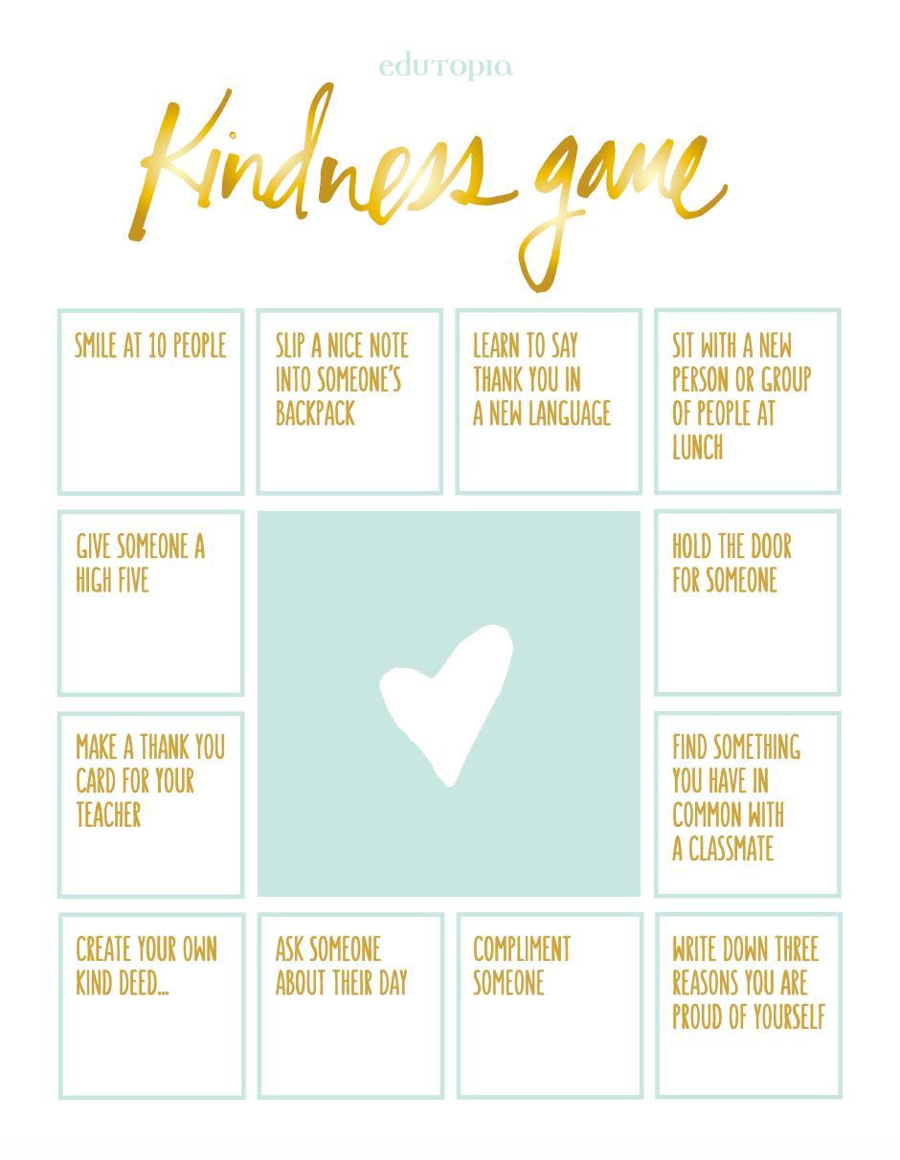
https://www.edutopia.org/discussion/kindness-game-activity
Notes:
The Kindness game board comes from https://www.edutopia.org/discussion/kindness-game-activity and can be downloaded from there.
Acts of Kindness Challenge
Invite the children to create a kindness container. It can be made out of a jar, a box, a bag, or anything they like.
Select something to be the kindness token such as stickers, beans, large seeds, etc
You can also use a kindness whiteboard, where every act of kindness is noted on the board.
Invite the children and parents to see how much kindness they can spread.
Whenever someone completes an act of kindness or witnesses and act of kindness, they put a seed in the jar and/or not it on the whiteboard.
It might be helpful for the family to set a goal of how many kindness each will perform during the week or month.
Check in weekly to see how they are doing at meeting the goal and when it is reached, share in a special celebration.
Talk about any changes that have occurred and explain that these positive changes are common outcomes of practicing kindness.
Here is a Choose Kindness Game – You can post the link in the Chat so parents can access it.
https://theinquisitivemom.com/2017/03/choose-kindness-game-2017-update.html

Slide 8
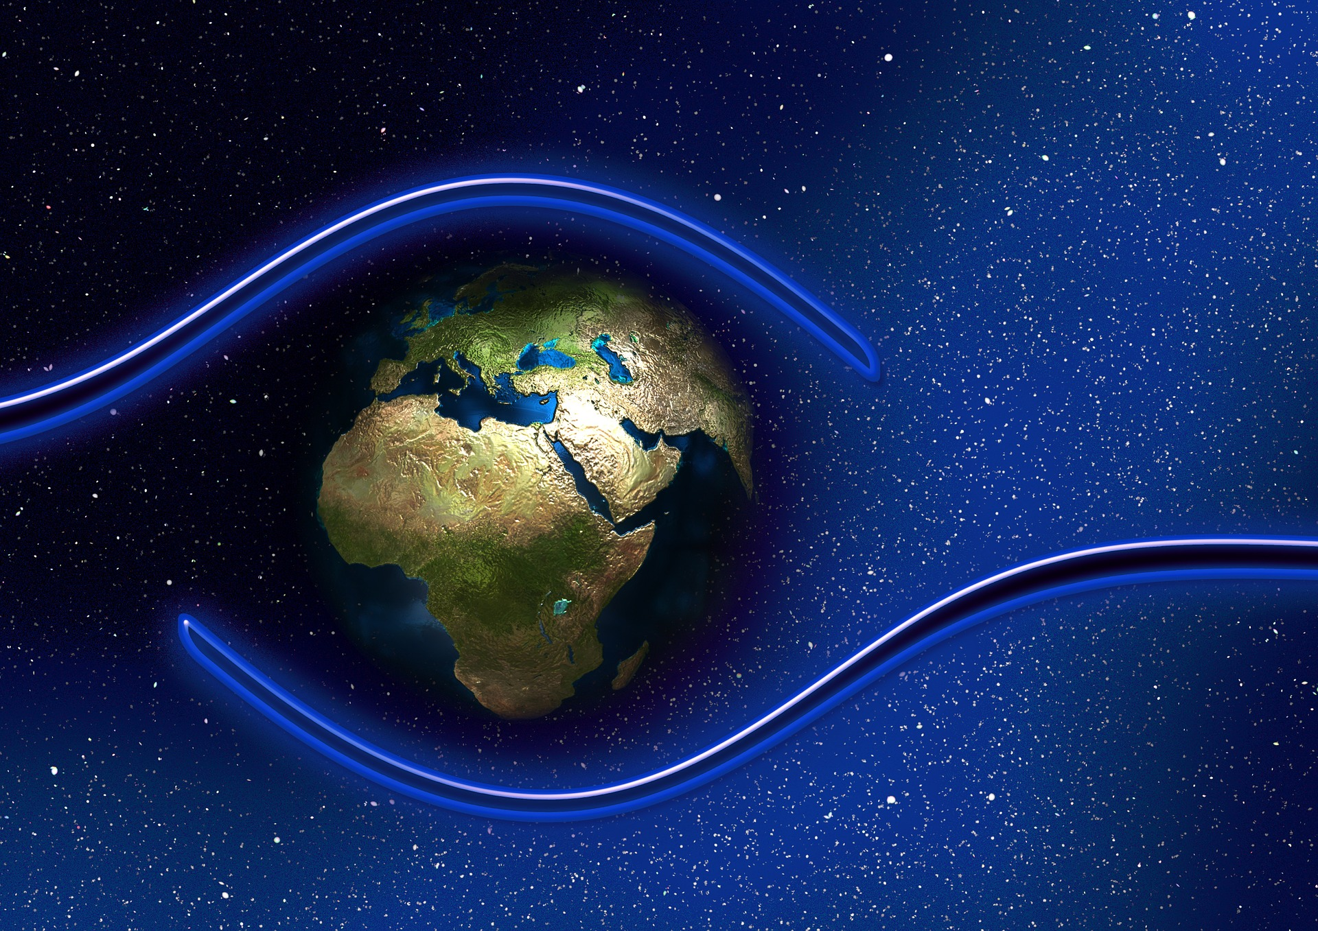
Prayer for Protection
The Light of God surrounds us
The Love of God enfolds us
The Power of God protects us
The Presence of God watches over us
Wherever we are God IS!
Notes:
Share the Prayer for Protection.
Also include other closing activities that are traditionally done in your ministry, if appropriate.
Then share the Goodbye song on the next slide

Slide 9
Notes:
Share the goodbye song!

